Slide 1


Commuting to Work - ETL _________________ How much money could one save annually by riding a bike to work? ____________________ Published by: Josh Jenkins

Slide 2



Data Collection
Disclaimer: This project is not testing a hypothesis, and is strictly for educational purposes
Scouted for relevant data
Ensured data was accessible and in a format that I knew how to work with
Primarily used CSV files
Had to scrape one web page using ParseHub to convert HTML to CSV by specifying which pieces of data I wanted to single out

Slide 3
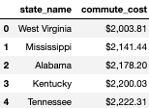
Step 1: Extract
Used CSV files from census.gov, indexmundi.com, streetlightdata.com, and businessinsider.com.
Used Pandas to create DataFrames from the CSVs

Slide 4


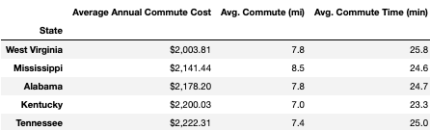
Step 2: Transform
Cleaning Data:
Set indices
Changed column names
Sorted Data
Merged Data Frames to create one large Data Frame for State data
Joined city Data Frames using concatination

Slide 5

Step 3: Load
Connected Pandas to PGAdmin Database using SQLAlchemy to load the result
Create tables using PostgreSQL that match Data Frames
Load all chosen data into the PGAdmin Database
Queries are now able to be pulled from each of the tables that were created

Slide 6

Project Outcomes
A person can query the DB and most likely check on how many people are estimated to already commute via bicycle in your area.
Amount spent on commuting is shown, which the implication is that:
(the amount spent - $150 for bike maintenance) = the amount you could save
A person can also check on average stats for their state in regard to distance of commute and time spent in vehicle while commuting

Slide 7
Things to Consider
PROS
CONS
Using this data, my hope is that any person living in the United States can make an educated guess on how much money they could potentially save if that person were to commute via bicycle to work instead of a vehicle. Also, just to educate themselves a bit on this opportunity.
Significant money savings
Positive effects on health/ fitness/ stress levels
No sitting in traffic
Putting less mileage on your vehicle, which potentially leads to cheaper annual maintenance expenses
Could save on parking expenses if an employee must pay to park
If you live farther from work, your bike commute could take a lot more of your time
Weather can play a big part
Bike maintenance can cost up to a few hundred dollars a year
Must carry work gear
Not everyone enjoys riding a bike, and some might not even know how

Slide 8
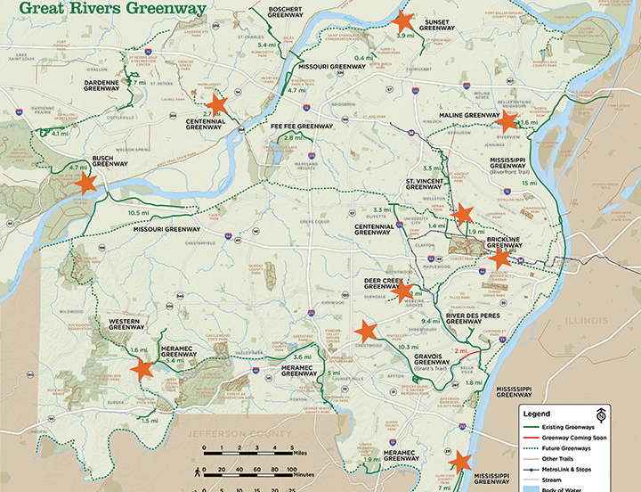
Cycling/ Walking to work is becoming much more accessible
In many states across the US, municipalities are spending more time and effort on paved/ gravel paths
For example, St. Louis Metro has created the Great Rivers Greenway which includes 128 miles of paths (and counting)
Cycling to work is becoming very popular in larger coastal cities and places that have nice weather year-round.

Slide 9

Random Commuting Info
For a bunch of random information on commuting data collected by the United States Census Bureau, check out this link:
https://data.census.gov/cedsci/table?g=0100000US&tid=ACSST5Y2017.S0801&q=S0801
870,000 members of the workforce in the USA currently ride their bike to work, which accounts for roughly 0.6% of the total workforce
For this study, the US Census Bureau stated they had reached out to one in every 38 households

Slide 10
Possible future endeavors
Go into much more depth and measure the different factors that effect the opportunity to commute via bicycle
Analyze how much money one person could save by using their current vehicles gas mileage, specific commute distance, current gas prices, and availability of commuting by something other than a vehicle

Slide 11
Sources
https://www.census.gov/library/publications/2014/acs/acs-25.html
https://www.bicycle-guider.com/bike-facts-stats/
https://gasprices.aaa.com/state-gas-price-averages/
https://www.businessinsider.com/average-spending-on-commute-how-much-money-2019-7#west-virginia-200381-1
https://www.indexmundi.com/facts/united-states/quick-facts/all-states/average-commute-time#table
https://www.streetlightdata.com/wp-content/uploads/2018/03/Commutes-Across-America_180201.pdf
https://medium.com/@aarontsuru/8-reasons-you-should-definitely-not-ride-your-bike-to-work-120ca800e18e

